Slide 1
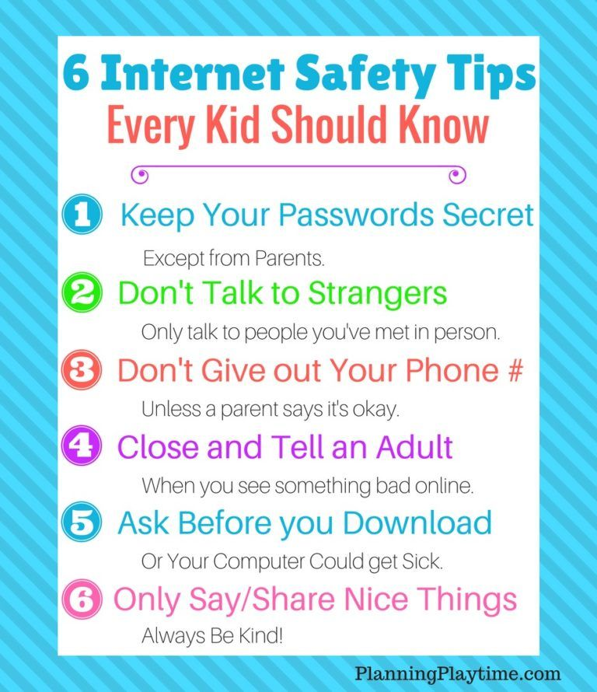
Dallas Elementary School
Title I Family Engagement
Click on items in the room to go to fun learning websites and see standard and curriculum information!
Click on an icon
to learn how to logon.
Markers
Glue
Paper
National Parental
Involvement Day,
November 17th
Pencils
Erasers
Crayons

Slide 2
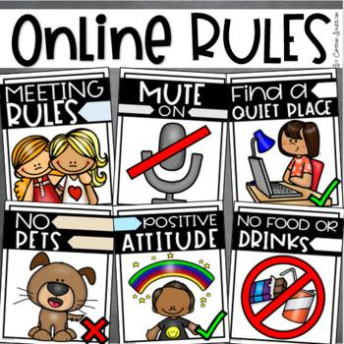
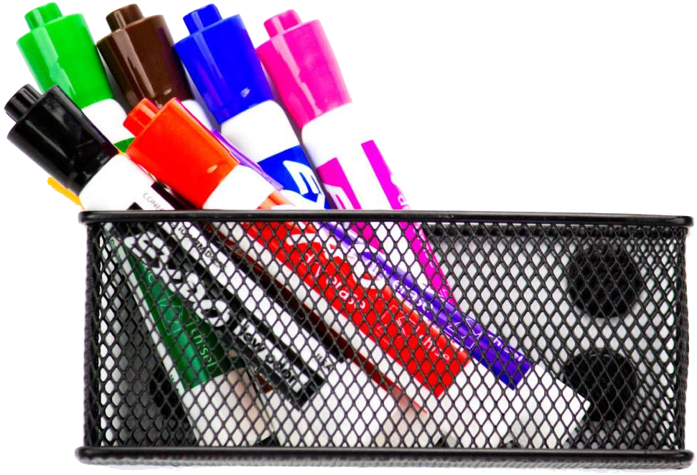
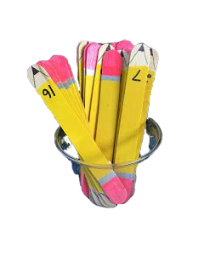
How to log on to Canvas
Go to the Paulding County webpage
Click on the student dashboard
Click on the elementary dashboard
Click on the Canvas icon
Sign in.
Logon: Student number
Password: Your 3 initials and you birthday
EXAMPLE: jholmes
jdh0887
To slide 1
Markers
Glue
Paper

Slide 3
How to log on to Office 365
Go to www.office.com
Click the “sign in”
Choose “work or school” account
You may need to sign in.
Logon: Student number@paulding.k12.ga.us
Password: Your 3 initials and you birthday
EXAMPLE: jholmes@paulding.k12.ga.us
jdh0887
Markers
Glue
Paper

